Slide 1
UNIT-IV
Collections: Overview, Collection Interfaces, Collection Classes, Iterators, List, Set, Maps, Comparator, Arrays, Legacy Classes and Interfaces, StringTokenizer, BitSet, Date, Calendar, Random, Flow, Timer.

Slide 2
Collections in Java is a framework that stores and manipulates a group of objects.
It is a hierarchy of interfaces and classes that provides an easy management of a group of objects.
Java Collection framework provides many interfaces (List, Queue, Deque, Set) and classes (ArrayList, Vector, LinkedList, PriorityQueue, HashSet, LinkedHashSet, TreeSet).

Slide 3
What is Java Collections Framework?
The Collections Framework is defined as a unified architecture for representing and manipulating collections.
In Java, the Collections Framework is a hierarchy of interfaces and classes that provides an easy management of a group of objects.
The java.util package contains the powerful tool of Collections Framework.

Slide 4
Advantages of the Collections Framework
Provides high-performance and high efficiency. This is due to the fact that various implementations of each interface are interchangeable, so programs can be written by switching implementations.
Some methods of each interface of the Collections Framework have a uniform implementation. The Collections API has basic interfaces like Set, Map and List, so the classes that implement them have a few common set of methods.
Reduces the programming effort by providing useful data structures and algorithms. We don't have to write our own data structure as it has already been provided to us.
Facilitates code reusability. Collections Framework provides common classes and interfaces that can be used with different types of collections.

Slide 5
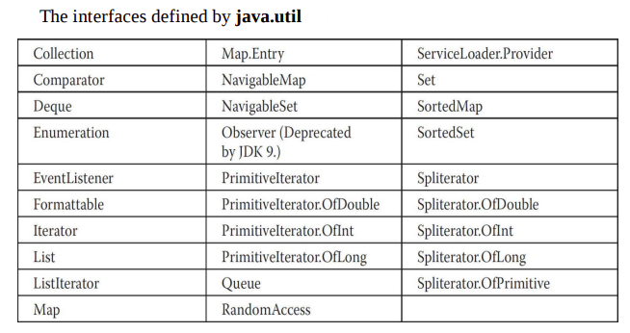

Slide 6
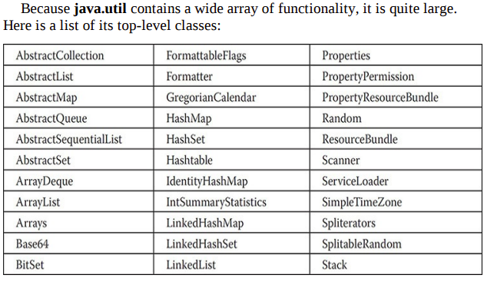

Slide 7
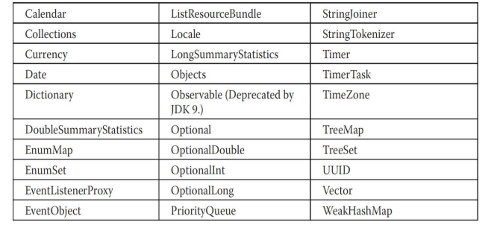

Slide 8
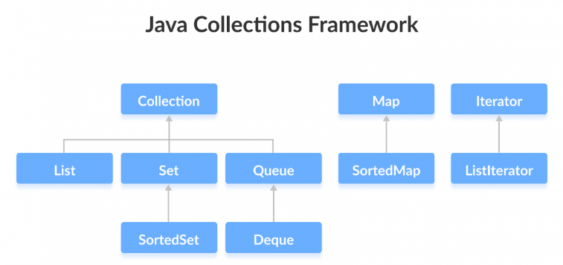

Slide 9
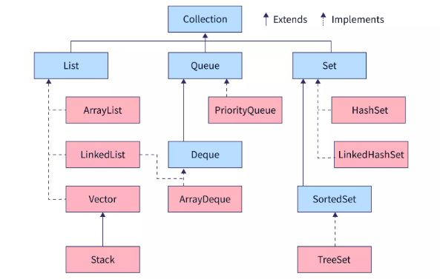

Slide 10
Collections class
Java provides a set of Collection classes that implements Collection interface. Some of these classes provide full implementations that can be used as it is and other abstract classes provides skeletal implementations.
Collections class provides static methods for sorting the elements of a collection.
If collection elements are of Set or Map, we can use TreeSet or TreeMap. However, we cannot sort the elements of List.
Collections class provides methods for sorting the elements of List type elements also.
public void sort(List list, Comparator c): is used to sort the elements of List by the given Comparator

Slide 11
Collection Interface
The Collection Interface is the root or the foundation on which the Collections Framework is built. It is a general interface that has the declaration.
interface Collection<E>
Here, E is the type of object that the collection will hold.
It provides the basic operations like adding, removing, clearing the elements in a collection, checking whether the collection is empty etc.
List, Queue and Set are the components that extend the Collection Interface. There is no direct implementation of this interface. However, it is implemented through its subinterfaces like List, Set, and Queue.

Slide 12
Collection vs Collections
The collection, a root level interface in the Java collection hierarchy, can be used to group numerous objects in a single unit. The objects grouped can be similar or different from each other. Common collection interfaces are set, list, map, stack, queue.
Collections is a utility class found in Java that only contains static methods that operate on or return collections. Collections provide an easier method for developers to perform basic operations on elements without getting into the operation details.
Most commonly used collection classes are: Collections.binarySearch(),Collections.sort(),Collections.max(),Collections.min(), Collections.reverse(), Collections.copy() .

Slide 13
Sub interfaces of Collection
List Interface
The List interface is an ordered collection that allows us to add and remove elements like an array.
2. Set Interface
The Set interface allows us to store elements in different sets similar to the set in mathematics. It cannot have duplicate elements.
3. Queue Interface
The Queue interface is used when we want to store and access elements in FIFO manner.

Slide 14
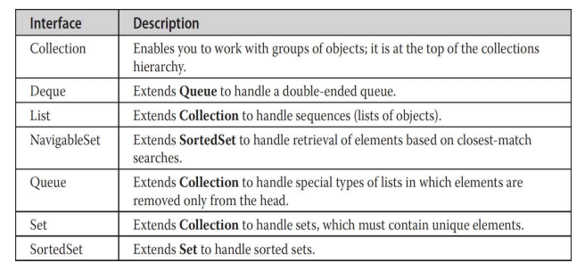

Slide 15
Methods of the Collection Interface
Method | Description
boolean add(E obj) | It is used to add an object obj to the collection. Returns true if obj was added, else returns false if the element obj was already a member and the collection does not allow duplicates.
boolean addAll(Collection<? extends E> c) | Adds all the elements of c to the collection.Returns true if the object was added, else returns false.
void clear() | Removes all the elements from the collection.
int size() | Returns the number of elements present in the collection.
Iterator iterator() | Returns an iterator for the collection. It is an object that can be used to loop through collections.
boolean contains(Object obj) | Checks if the object is present in the collection and returns true if found. Else, it returns false.

Slide 16
Methods of the Collection Interface
boolean containsAll(Collection<?> c) | Returns true if the collection contains all the elements of c, else returns false.
int hashCode() | It returns the hash code for the collection i.e., returns an integer or a 4 byte value which is generated by the hashing algorithm.
boolean equals(Object obj) | It returns true if the collection and obj are equal, else returns false.
boolean isEmpty() | Returns true if the collection is empty, else returns false.
boolean remove(Object obj) | Removes one instance of obj from the collection. It returns true if the element was removed, else returns false.
boolean removeAll(Collection<?> c) | Removes all elements of c from the collection. Returns true if the elements were removed, else returns false.
boolean retainAll(Collection<?> c) | It retains only those elements which are in c and removes the other elements from the collection. It returns true if the elements were removed, else returns false.
default Spliterator spliterator() | Returns a spliterator to the collection. A spliterator can be used to iterate over a collection and split it into **multiple sets.

Slide 17
// Java program to demonstrate
// why collection framework was needed
import java.io.*;
import java.util.*;
class CollectionDemo {
public static void main(String[] args)
{
// Creating instances of the array,
// vector and hashtable
int arr[] = new int[] { 1, 2, 3, 4 };
Vector<Integer> v = new Vector();
Hashtable<Integer, String> h = new Hashtable();
// Adding the elements into the
// vector
v.addElement(1);
v.addElement(2);
// Adding the element into the

Slide 18
// hashtable
h.put(1, "geeks");
h.put(2, "4geeks");
// Array instance creation requires [],
// while Vector and hastable require ()
// Vector element insertion requires addElement(),
// but hashtable element insertion requires put()
// Accessing the first element of the
// array, vector and hashtable
System.out.println(arr[0]);
System.out.println(v.elementAt(0));
System.out.println(h.get(1));
// Array elements are accessed using [],
// vector elements using elementAt()
// and hashtable elements using get()
}
}

Slide 19
List Interface
The list interface extends the collection interface. A list is used to store ordered collection of data and it may contain duplicates.
Ordered collection means the order in which the elements are being inserted and they contain a specific value. The elements present, can be accessed or inserted by their position in the list using zero-based indexing.
The list interface is implemented by LinkedList, ArrayList, Vectors and Stack classes. They are an important part of collections in Java.

Slide 20
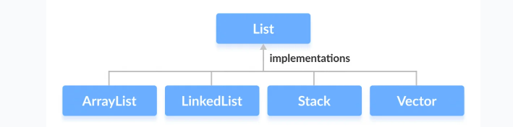

Slide 21
ArrayList Vs Array
In Java, we need to declare the size of an array before we can use it. Once the size of an array is declared, it's hard to change it.
To handle this issue, we can use the ArrayList class. It allows us to create resizable arrays.
Unlike arrays, arraylists can automatically adjust their capacity when we add or remove elements from them. Hence, arraylists are also known as dynamic arrays.

Slide 22
ArrayList
ArrayList provides us with dynamic arrays in Java. Though, it may be slower than standard arrays but can be helpful in programs where lots of manipulation in the array is needed.
The size of an ArrayList is increased automatically if the collection grows or shrinks if the objects are removed from the collection.
Java ArrayList allows us to randomly access the list. ArrayList can not be used for primitive types, like int, char, etc. We will need a wrapper class for such cases.

Slide 23
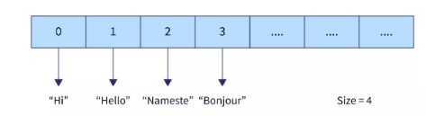
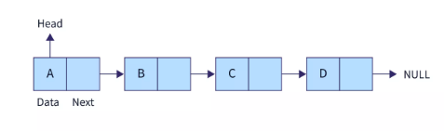

Slide 24
// Java program to demonstrate the
// working of ArrayList
import java.io.*;
import java.util.*;
class GFG {
// Main Method
public static void main(String[] args)
{
// Declaring the ArrayList with
// initial size n
ArrayList<Integer> al = new ArrayList<Integer>();
// Appending new elements at
// the end of the list
for (int i = 1; i <= 5; i++)

Slide 25
al.add(i);
// Printing elements
System.out.println(al);
// Remove element at index 3
al.remove(3);
// Displaying the ArrayList
// after deletion
System.out.println(al);
// Printing elements one by one
for (int i = 0; i < al.size(); i++)
System.out.print(al.get(i) + " ");
}
}

Slide 26
LinkedList
LinkedList class is an implementation of the LinkedList data structure which is a linear data structure where the elements are not stored in contiguous locations and every element is a separate object with a data part and address part.
The elements are linked using pointers and addresses. Each element is known as a node.

Slide 27
import java.util.*;
public class Topics{
public static void main(String args[]){
//creating a LinkedList
LinkedList<String> list= new LinkedList<String>();
//displaying the initial size
System.out.println("Size at the beginning "+list.size());
//add elements
list.add("Java");
list.add("C++");
list.add("JavaScript");
list.addFirst("C#");
list.addLast("Kotlin");
list.add(2,"Python");

Slide 28
//displaying the LinkedList
System.out.println("Original Linked List " + list);
//displaying the size
System.out.println("Size after addition "+list.size());
//remove element at index 5
list.remove(5);
list.remove("C#");
//display the new LinkedList
System.out.println("New Linked List "+ list);
//display the new size
System.out.println("Size after removal "+list.size());
}
}

Slide 29
Vector
Like ArrayList, Vectors in Java are used for dynamic arrays.It extends the AbstractList and implements the List interface.
Vector is synchronised. Synchronised means only one thread at a time can access the code. This means if one thread is working on Vector, no other thread can get a hold of it.
Only one operation on vector can be performed at a time. For example, if addition is being performed by one thread, other operation cannot be performed until the first one is over.

Slide 30
Methods in vector class
Add Elements to Vector
add(element) - adds an element to vectors
add(index, element) - adds an element to the specified position
addAll(vector) - adds all elements of a vector to another vector
Access Vector Elements
get(index) - returns an element specified by the index
iterator() - returns an iterator object to sequentially access vector elements
remove(index) - removes an element from specified position
removeAll() - removes all the elements

Slide 31
Methods in vector class
clear() - removes all elements. It is more efficient than removeAll()
set()changes an element of the vector
size()returns the size of the vector
toArray()converts the vector into an array
toString()converts the vector into a String
contains()searches the vector for specified element and returns a boolean result

Slide 32
import java.util.*;
public class Topics{
public static void main(String args[]){
//creating a Vector
Vector<Integer> v= new Vector<Integer>();
//displaying the size
System.out.println("Size at the beginning "+v.size());
//add elements
v.add(19);
v.add(88);
v.add(1);
v.add(39);

Slide 33
//displaying the Vector
System.out.println(v);
//displaying the size
System.out.println("Size after addition "+v.size());
//remove element at index 3
v.remove(3);
//display the new Vector
System.out.println(v);
//display the new size
System.out.println("Size after removal "+v.size());
}
}

Slide 34
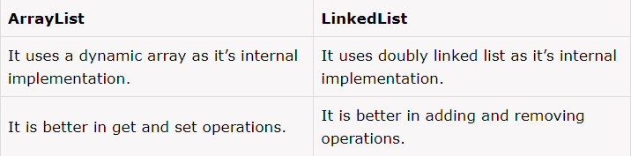
ArrayList provides the mechanism of random access because of it’s index based nature.
LinkedList does not provides any facility like random access. Its performance is better than Arraylist on add and remove operations, but worse on get and set operations.

Slide 35
ArrayList | Vector
It is not synchronized. | It is synchronized.
It is not a legacy class. | It is a legacy class.
It increases its size by 50% of the array size. | It increases its size by doubling the array size i.e. 100%.
Iterator interface is used to traverse the ArrayList elements. | Iterator or Enumeration interface can be used to traverse the Vector elements.
ArrayList is much fast than Vector because it is non-synchronized. | Vector is slow as compared ArrayList because it is synchronized

Slide 36
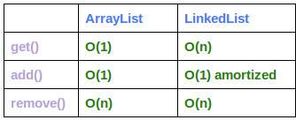
Performance of ArrayList vs. LinkedList

Slide 37
import java.io.*;
import java.util.*; public class Main
{
public static void main (String[] args)
{
ArrayList<Integer> arrayList = new ArrayList<Integer>();
LinkedList<Integer> linkedList = new LinkedList<Integer>();
// ArrayList add operation
long startTime = System.nanoTime();
for (int i = 0; i < 100000; i++) {
arrayList.add(i);
}
long endTime = System.nanoTime();
long duration = endTime - startTime;
System.out.println("Time Taken by ArrayList in add operation: " + duration);

Slide 38
// LinkedList add operation
startTime = System.nanoTime();
for (int i = 0; i < 100000; i++) {
linkedList.add(i);
}
endTime = System.nanoTime();
duration = endTime - startTime;
System.out.println("Time Taken by LinkedList in add operation: " + duration);
// ArrayList get operation
startTime = System.nanoTime();
for (int i = 0; i < 10000; i++) {
arrayList.get(i);
}
endTime = System.nanoTime();
duration = endTime - startTime;
System.out.println("Time Taken by ArrayList in get operation: " + duration);

Slide 39
// LinkedList get operation
startTime = System.nanoTime();
for (int i = 0; i < 10000; i++) {
linkedList.get(i);
}
endTime = System.nanoTime();
duration = endTime - startTime;
System.out.println("Time Taken by LinkedList in get operation: " + duration);
// ArrayList remove operation
startTime = System.nanoTime();
for (int i = 9999; i >=0; i--) {
arrayList.remove(i);
}
endTime = System.nanoTime();
duration = endTime - startTime;
System.out.println("Time Taken by ArrayList in remove operation: " + duration);

Slide 40
// LinkedList remove operation
startTime = System.nanoTime();
for (int i = 9999; i >=0; i--) {
linkedList.remove(i);
}
endTime = System.nanoTime();
duration = endTime - startTime;
System.out.println("Time Taken by LinkedList in remove operation: " + duration); }
}

Slide 41
Java Stack Class
The Java collections framework has a class named Stack that provides the functionality of the stack data structure.
The Stack class extends the Vector class.
In stack, elements are stored and accessed in Last In First Out manner. That is, elements are added to the top of the stack and removed from the top of the stack.
Creating a Stack
In order to create a stack, we must import the java.util.Stack package first. Once we import the package, here is how we can create a stack in Java.
Stack<Type> stacks = new Stack<>();

Slide 42
Stack Methods
push() Method
pop() Method
peek() Method
search() Method
empty() Method

Slide 43
import java.util.Stack;
class Main {
public static void main(String[] args) {
Stack<String> animals= new Stack<>();
// Add elements to Stack
animals.push("Dog");
animals.push("Horse");
animals.push("Cat");
System.out.println("Stack: " + animals);
// Search an element
int position = animals.search("Horse");
System.out.println("Position of Horse: " + position);
}
}

Slide 44
Use ArrayDeque Instead of Stack
The Stack class provides the direct implementation of the stack data structure. However, it is recommended not to use it.
Instead, use the ArrayDeque class (implements the Deque interface) to implement the stack data structure in Java.
A Deque is a double ended queue. It can be used as a Queue or a Stack.

Slide 45
How to Create a Deque?
The java.util.Deque interface cannot be instantiated directly.
An interface only describes which methods a class implementing this interface must implement.
Deque<Integer> deque = new ArrayDeque<>();
concrete deque classes offered by the JDK
Java ArrayDeque
Java LinkedList
Java ConcurrentLinkedDeque
Java LinkedBlockingDeque

Slide 46
Set Interface
The Set interface defines an unordered collection.
It extends the Collection Interface.
We cannot store duplicate values in this.
The Set Interface is implemented by popular classes like HashedSet, LinkedHashSet and TreeSet.

Slide 47
Set Operations
The Java Set interface allows us to perform basic mathematical set operations like union, intersection, and subset.
Union - to get the union of two sets x and y, we can use x.addAll(y)
Intersection - to get the intersection of two sets x and y, we can use x.retainAll(y)
Subset - to check if x is a subset of y, we can use y.containsAll(x)
Difference of Sets -To calculate the difference between the two sets, we can use the removeAll() method.

Slide 48
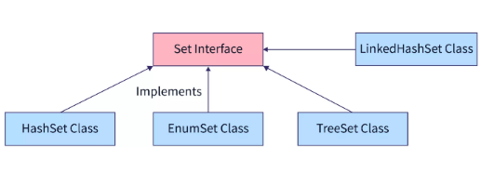

Slide 49
HashSet
The HashSet class implements the Set Interface.
It uses a hash table for storage which uses a mechanism called Hashing.
In hashing, the informational content of a key determines a unique value, called its hash code.
The hash code is then used as an index, at which the data associated with the key is stored.
When we insert elements into the HashSet, it is not guaranteed that it gets stored in the same order.

Slide 50
HashSet
HashSet is non-synchronized means multiple threads at a time can access the code.
This means if one thread is working on HashSet, other threads can also get a hold of it. Multiple operations on HashSet can be performed at a time.
For example, if addition is being performed by one thread, other operation can be performed by some other thread too.

Slide 51
Methods Of HashSet
clone()Creates a copy of the HashSet
contains()Searches the HashSet for the specified element and returns a boolean result
isEmpty()Checks if the HashSet is empty
size()Returns the size of the HashSet
clear()Removes all the elements from the HashSet

Slide 52
import java.util.*;
public class HashSet{
public static void main(String args[]){
//creating a HashSet
HashSet<String> str= new HashSet<String>();
//displaying the initial size
System.out.println("Size at the beginning "+str.size());
//add elements
str.add("Hello");
str.add("Hi");
str.add("Namaste");
str.add("Bonjour");

Slide 53
//displaying the HashSet
System.out.println(str);
//displaying the size
System.out.println("Size after addition "+str.size());
//remove element using value
str.remove("Bonjour");
//display the new HashSet
System.out.println(str);
//display the new size
System.out.println("Size after removal "+str.size());
}
}

Slide 54
Implementing HashSet Class for Union of two sets
import java.util.Set;
import java.util.HashSet;
class Main {
public static void main(String[] args) {
// Creating a set using the HashSet class
Set<Integer> set1 = new HashSet<>();
// Add elements to the set1
set1.add(2);
set1.add(3);
System.out.println("Set1: " + set1);

Slide 55
// Creating another set using the HashSet class
Set<Integer> set2 = new HashSet<>();
// Add elements
set2.add(1);
set2.add(2);
System.out.println("Set2: " + set2);
// Union of two sets
set2.addAll(set1);
System.out.println("Union is: " + set2);
}
}

Slide 56
LinkedHashSet
The LinkedHashSet class extends the HashSet class.
It maintains a linked list of entries in the set and hence maintains the order in which they were inserted.
LinkedHashSet is non-synchronized means multiple threads at a time can access the code. This means if one thread is working on LinkedHashSet, other threads can also get a hold of it.
Multiple operations on LinkedHashSet can be performed at a time. For example, if addition is being performed by one thread, other operation can be performed by some other thread too.

Slide 57
Methods to create the constructors of HashSet
Creating an empty LinkedHashSet It is used to create an empty LinkedHashSet object.
Creating a LinkedHashSet with a specified size It is used to create a LinkedHashSet with the given size.
Creating a LinkedHashSet with a specified size and fill ratio It is used to create a LinkedHashSet with a given size and fill ratio. Fill ratio determines how full the hash set can be before it is resized.
Creating a LinkedHashSet from Collection It is used to create a LinkedHashSet which contains all the elements from the collection.

Slide 58
LinkedHashSet<E> hs = new LinkedHashSet<E>();
LinkedHashSet<E> hs = new LinkedHashSet<E>(Collection c);
LinkedHashSet<E> hs = new LinkedHashSet<E>(int size);
LinkedHashSet<Data-type> lhs = new LinkedHashSet<Data-type>(int size,float fillRatio);

Slide 59
Intersection of Sets
import java.util.LinkedHashSet;
class Main {
public static void main(String[] args) {
LinkedHashSet<Integer> primeNumbers = new LinkedHashSet<>();
primeNumbers.add(2);
primeNumbers.add(3);
System.out.println("LinkedHashSet1: " + primeNumbers);
LinkedHashSet<Integer> evenNumbers = new LinkedHashSet<>();
evenNumbers.add(2);
evenNumbers.add(4);
System.out.println("LinkedHashSet2: " + evenNumbers);
// Intersection of two sets
evenNumbers.retainAll(primeNumbers);
System.out.println("Intersection is: " + evenNumbers);
}
}

Slide 60
TreeSet
The TreeSet class implements the Set Interface.It uses a tree to store the elements.
TreeSet contains unique elements. It stores elements sorted ascending order.
The access and retrieval time is very fast.
TreeSet is non-synchronized means multiple threads at a time can access the code. This means if one thread is working on TreeSet, other threads can also get a hold of it.
Multiple operations on TreeSet can be performed at a time. For example, if addition is being performed by one thread, other operations can be performed by some other thread too.

Slide 61
Methods for Navigation
The TreeSet class implements NavigableSet, it provides various methods to navigate over the elements of the tree set.
first() and last() Methods
first() - returns the first element of the set
last() - returns the last element of the set
2. ceiling(), floor(), higher() and lower() Methods
3. pollfirst() and pollLast() Methods
pollFirst() - returns and removes the first element from the set
pollLast() - returns and removes the last element from the set
4. headSet(), tailSet() and subSet() Methods

Slide 62
Subset of a Set
import java.util.TreeSet;
class Main {
public static void main(String[] args) {
TreeSet<Integer> numbers = new TreeSet<>();
numbers.add(1);
numbers.add(2);
numbers.add(3);
numbers.add(4);
System.out.println("TreeSet1: " + numbers);

Slide 63
TreeSet<Integer> primeNumbers = new TreeSet<>();
primeNumbers.add(2);
primeNumbers.add(3);
System.out.println("TreeSet2: " + primeNumbers);
// Check if primeNumbers is subset of numbers
boolean result = numbers.containsAll(primeNumbers);
System.out.println("Is TreeSet2 subset of TreeSet1? " + result);
}
}

Slide 64
Java EnumSet
Creating EnumSet
In order to create an enum set, we must import the java.util.EnumSet package first.
Unlike other set implementations, the enum set does not have public constructors. We must use the predefined methods to create an enum set.

Slide 65
Using allOf(Size)
Using noneOf(Size)
Using range(e1, e2) Method
Using of() Method
Methods of EnumSet

Slide 66
Access EnumSet Elements
import java.util.EnumSet;
import java.util.Iterator;
class Main {
enum Size {
SMALL, MEDIUM, LARGE, EXTRALARGE
}
public static void main(String[] args) {
// Creating an EnumSet using allOf()
EnumSet<Size> sizes = EnumSet.allOf(Size.class);
Iterator<Size> iterate = sizes.iterator();
System.out.print("EnumSet: ");
while(iterate.hasNext()) {
System.out.print(iterate.next());
System.out.print(", ");
}
}
}

Slide 67
LinkedHashSet Vs. HashSet
Both LinkedHashSet and HashSet implements the Set interface. However, there exist some differences between them.
LinkedHashSet maintains a linked list internally. Due to this, it maintains the insertion order of its elements.
The LinkedHashSet class requires more storage than HashSet. This is because LinkedHashSet maintains linked lists internally.
The performance of LinkedHashSet is slower than HashSet. It is because of linked lists present in LinkedHashSet

Slide 68
LinkedHashSet Vs. TreeSet
The TreeSet class implements the SortedSet interface. That's why elements in a tree set are sorted. However, the LinkedHashSet class only maintains the insertion order of its elements.
A TreeSet is usually slower than a LinkedHashSet. It is because whenever an element is added to a TreeSet, it has to perform the sorting operation.
LinkedHashSet allows the insertion of null values. However, we cannot insert a null value to TreeSet.

Slide 69
Map Interface
A map is an object that stores key and value pairs.
It contains unique keys as the same key cannot have multiple mappings.
Although a part of the Collections Framework, maps are not themselves collections because they do not implement the Collection Interface.
In Java, elements of Map are stored in key/value pairs. Keys are unique values associated with individual Values.
A map cannot contain duplicate keys. And, each key is associated with a single value.

Slide 70
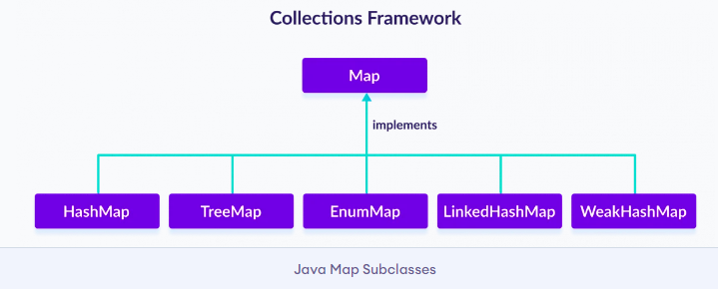
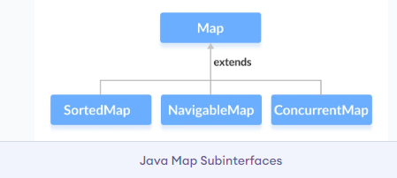
Classes that implement Map
Since Map is an interface, we cannot create objects from it.

Slide 71
Methods of Map
The Map interface includes all the methods of the Collection interface. It is because Collection is a super interface of Map, the Map interface also includes the following methods
put(K, V) - Inserts the association of a key K and a value V into the map. If the key is already present, the new value replaces the old value.
putAll() - Inserts all the entries from the specified map to this map.
putIfAbsent(K, V) - Inserts the association if the key K is not already associated with the value V.
get(K) - Returns the value associated with the specified key K. If the key is not found, it returns null.
getOrDefault(K, defaultValue) - Returns the value associated with the specified key K. If the key is not found, it returns the defaultValue.

Slide 72
containsKey(K) - Checks if the specified key K is present in the map or not.
containsValue(V) - Checks if the specified value V is present in the map or not.
replace(K, V) - Replace the value of the key K with the new specified value V.
replace(K, oldValue, newValue) - Replaces the value of the key K with the new value newValue only if the key K is associated with the value oldValue.
remove(K) - Removes the entry from the map represented by the key K.
remove(K, V) - Removes the entry from the map that has key K associated with value V.
keySet() - Returns a set of all the keys present in a map.
values() - Returns a set of all the values present in a map.
entrySet() - Returns a set of all the key/value mapping present in a map.

Slide 73
HashMap
The HashMap class extends AbstractMap and implements the Map interface.
It uses a hash table for storing key-value pairs.
HashMap does not maintain order of its element.
HashMap has four constructor.
HashMap()
HashMap(Map< ? extends k, ? extends V> m)
HashMap(int capacity)
HashMap(int capacity, float fillratio)

Slide 74
import java.util.*;
public class Topics {
public static void main(String args[])
{
// Creating a HashMap
HashMap<Integer, Double> hm = new HashMap<Integer, Double>();
//adding key value pairs using put()
hm.put(1, 1.9);
hm.put(2, 2.8);
hm.put(3, 3.7);
// Finding the value for a key using get()
System.out.println("The Value for 1 is " + hm.get(1));
}
}

Slide 75
Creating HashMap from Other Maps
import java.util.HashMap;
import java.util.TreeMap;
class Main {
public static void main(String[] args) {
// create a treemap
TreeMap<String, Integer> evenNumbers = new TreeMap<>();
evenNumbers.put("Two", 2);
evenNumbers.put("Four", 4);
System.out.println("TreeMap: " + evenNumbers);
// create hashmap from the treemap
HashMap<String, Integer> numbers = new HashMap<>(evenNumbers);
numbers.put("Three", 3);
System.out.println("HashMap: " + numbers);
}
}

Slide 76
LinkedHashMap Vs. HashMap
LinkedHashMap maintains a doubly-linked list internally. Due to this, it maintains the insertion order of its elements.
The LinkedHashMap class requires more storage than HashMap. This is because LinkedHashMap maintains linked lists internally.
The performance of LinkedHashMap is slower than HashMap.

Slide 77
HashMap and WeakHashMap
keys of weak hashmaps are of weak reference type. This means the entry of a map are removed by the garbage collector if the key to that entry is no longer used. This is useful to save resources.
keys of hashmaps are of strong reference type. This means the entry of a map is not removed by the garbage collector even though the key to that entry is no longer used.

Slide 78
import java.util.WeakHashMap;
class Main {
public static void main(String[] args) {
// Creating WeakHashMap of numbers
WeakHashMap<String, Integer> numbers = new WeakHashMap<>();
String two = new String("Two");
Integer twoValue = 2;
String four = new String("Four");
Integer fourValue = 4;
// Inserting elements
numbers.put(two, twoValue);
numbers.put(four, fourValue);
System.out.println("WeakHashMap: " + numbers);

Slide 79
// Make the reference null
two = null;
// Perform garbage collection
System.gc();
System.out.println("WeakHashMap after garbage collection: " + numbers);
}
}
Output
WeakHashMap: {Four=4, Two=2}
WeakHashMap after garbage collection: {Four}

Slide 80
Replace EnumMap Elements
import java.util.EnumMap;
class Main {
enum Size {
SMALL, MEDIUM, LARGE, EXTRALARGE
}
public static void main(String[] args) {
// Creating an EnumMap of the Size enum
EnumMap<Size, Integer> sizes = new EnumMap<>(Size.class);
sizes.put(Size.SMALL, 28);
sizes.put(Size.MEDIUM, 32);
sizes.put(Size.LARGE, 36);
sizes.put(Size.EXTRALARGE, 40);
System.out.println("EnumMap: " + sizes);

Slide 81
// Using the replace() Method
sizes.replace(Size.MEDIUM, 30);
sizes.replace(Size.LARGE, 36, 34);
System.out.println("EnumMap using replace(): " + sizes);
// Using the replaceAll() Method
sizes.replaceAll((key, oldValue) -> oldValue + 3);
System.out.println("EnumMap using replaceAll(): " + sizes);
}
}
Output
EnumMap: {SMALL=28, MEDIUM=32, LARGE=36, EXTRALARGE=40}
EnumMap using replace(): {SMALL=28, MEDIUM=30, LARGE=34, EXTRALARGE=40}
EnumMap using replaceAll(): {SMALL=31, MEDIUM=33, LARGE=37, EXTRALARGE=43}

Slide 82
EnumSet Vs. EnumMap
Both the EnumSet and EnumMap class provides data structures to store enum values. However, there exist some major differences between them.
Enum set is represented internally as a sequence of bits, whereas the enum map is represented internally as arrays.
Enum set is created using its predefined methods like allOf(), noneOf(), of(), etc. However, an enum map is created using its constructor.

Slide 83
The Queue Interface
It extends collection interface and defines behaviour of queue, that is first-in, first-out.
It's general declaration is,
interface Queue < E >
The Dequeue Interface
It extends Queue interface and declares behaviour of a double-ended queue. Its general declaration is,
interface Dequeue < E >
Double ended queues can function as simple queues as well as like standard Stacks.

Slide 84
Methods | Description
poll() | removes element at the head of the queue and returns null if queue is empty
remove() | removes element at the head of the queue and throws NoSuchElementException if queue is empty
peek() | returns the element at the head of the queue without removing it. Returns null if queue is empty
element() | same as peek(), but throws NoSuchElementException if queue is empty
offer( E obj ) | Adds object to queue.

Slide 85
Iterator Interface
Iterator is an object that can be used to loop through collections. As the name suggests, it is used to iterate over the elements. It is used to modify and iterate over the elements in a collection.
There are 3 methods in the Iterator interface:
public Object next()- It returns the next element in the collection. It throws the exception of NoSuchElementException if there is no next element.
public void remove()- It removes the current element from the collection.
public boolean hasNext()- It returns true if there are more elements in the collection. Else, returns false.

Slide 86
Accessing a Collection
To access, modify or remove any element from any collection we need to first find the element, for which we have to cycle throught the elements of the collection.
There are three possible ways to cycle through the elements of any collection.
Using Iterator interface
Using ListIterator interface
Using for-each loop

Slide 87
Accessing elements using Iterator
Iterator Interface is used to traverse a list in forward direction, enabling you to remove or modify the elements of the collection. Each collection classes provide iterator() method to return an iterator.
Accessing element using ListIterator
ListIterator Interface is used to traverse a list in both forward and backward direction. It is available to only those collections that implement the List Interface.

Slide 88
import java.util.ArrayList;
import java.util.Iterator;
class Main {
public static void main(String[] args) {
// Creating an ArrayList
ArrayList<Integer> numbers = new ArrayList<>();
numbers.add(1);
numbers.add(3);
numbers.add(2);
System.out.println("ArrayList: " + numbers);
// Creating an instance of Iterator
Iterator<Integer> iterate = numbers.iterator();

Slide 89
// Using the next() method
int number = iterate.next();
System.out.println("Accessed Element: " + number);
// Using the remove() method
iterate.remove();
System.out.println("Removed Element: " + number);
System.out.print("Updated ArrayList: ");
// Using the hasNext() method
while(iterate.hasNext()) {
// Using the forEachRemaining() method
iterate.forEachRemaining((value) -> System.out.print(value + ", "));
}
}
}

Slide 90
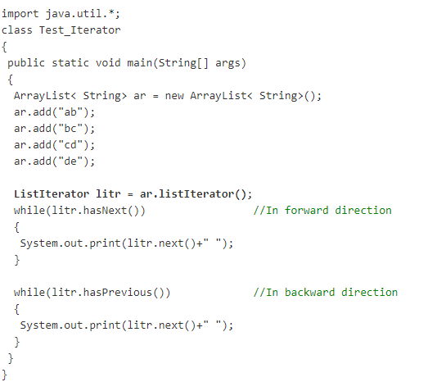

Slide 91
Using for-each loop
for-each version of for loop can also be used for traversing each element of a collection. But this can only be used if we don't want to modify the contents of a collection and we don't want any reverse access.
for-each loop can cycle through any collection of object that implements Iterable interface.

Slide 92
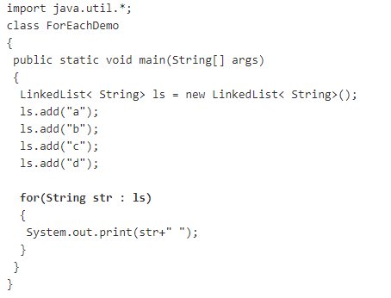

Slide 93
What is Comparable in Java?
Comparable is an interface in Java that enables comparing an object with other objects of the same type.
Comparable interface is provided by the java.lang package. Several built-in classes in Java like Integer, Double, String, etc., implement the Comparable interface.
Comparable is used for sorting objects by natural or default ordering, meaning the object itself knows how it has to be ordered. Example: The SuperHero objects should be ordered by id.

Slide 94
What is Comparator in Java?
Comparator is a functional interface in Java that can be used to sort objects, and it is provided by the java.util package.
A functional interface is an interface that contains exactly one abstract method. It is also called Single Abstract Method (SAM) Interfaces.
If a class implements the Comparable interface, then it is aware of how to sort itself because the class itself has implemented the compareTo() method. This is called default ordering. Comparator is used for custom ordering where the class is unaware of the ordering logic.

Slide 95
Methods of Java Comparator Interface
public int compare(Object obj1, Object obj2)It compares the first object with the second object.
public boolean equals(Object obj)It is used to compare the current object with the specified object.
public boolean equals(Object obj)It is used to compare the current object with the specified object.

Slide 96
Comparable | Comparator
Comparable is an interface in Java. | Comparator is a functional interface in Java.
Comparable provides compareTo() method to sort objects. | Comparator provides compare() method to sort objects.
Comparable is a part of the Java.lang package. | Comparator is a part of the java.util package.
Comparable can be used for natural or default ordering. | Comparator can be used for custom ordering.
Comparable provides a single sorting sequence. Ex: Sort either by id or name | Comparator provides multiple sorting sequences. Ex. Sort by both id and name.
Comparable modifies the class that implements it. | Comparator doesn't modify any class.

Slide 97
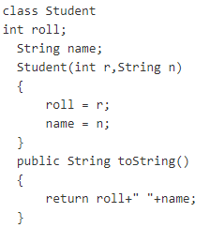
Student object will be sorted in ascending order of their roll.

Slide 98
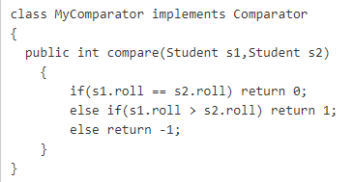
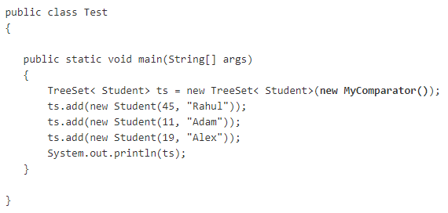

Slide 99
Student.java
This class contains three fields rollno, name and age and a parameterized constructor.
class Student{
int rollno;
String name;
int age;
Student(int rollno,String name,int age){
this.rollno=rollno;
this.name=name;
this.age=age;
}
}

Slide 100
AgeComparator.java
import java.util.*;
class AgeComparator implements Comparator{
public int compare(Object o1,Object o2){
Student s1=(Student)o1;
Student s2=(Student)o2;
if(s1.age==s2.age)
return 0;
else if(s1.age>s2.age)
return 1;
else
return -1;
}
}

Slide 101
NameComparator.java
import java.util.*;
class NameComparator implements Comparator{
public int compare(Object o1,Object o2){
Student s1=(Student)o1;
Student s2=(Student)o2;
return s1.name.compareTo(s2.name);
}
}

Slide 102
Simple.java
import java.util.*;
import java.io.*;
class Simple{
public static void main(String args[]){
ArrayList al=new ArrayList();
al.add(new Student(101,"Vijay",23));
al.add(new Student(106,"Ajay",27));
al.add(new Student(105,"Jai",21));
System.out.println("Sorting by Name");
Collections.sort(al,new NameComparator());
Iterator itr=al.iterator();
while(itr.hasNext()){
Student st=(Student)itr.next();
System.out.println(st.rollno+" "+st.name+" "+st.age);
}

Slide 103
System.out.println("Sorting by age");
Collections.sort(al,new AgeComparator());
Iterator itr2=al.iterator();
while(itr2.hasNext()){
Student st=(Student)itr2.next();
System.out.println(st.rollno+" "+st.name+" "+st.age);
}
}
}
output
Sorting by Name
106 Ajay 27
105 Jai 21
101 Vijay 23
Sorting by age
105 Jai 21
101 Vijay 23
106 Ajay 27

Slide 104
Arrays Class
We get overloaded methods for most of the data types by the arrays class. The Arrays class is extended from the Object class and the methods that it provides are the methods of the object class.
Methods provide provided by the Arrays class help us to perform useful tasks on arrays conveniently without the use of loops.
Arrays class is a part of the Java collection framework in the java.util package. It only consists of static methods and methods of the object class.
Using Arrays, we can create, compare, sort, search, stream, and transform arrays. We can access the methods of this class easily by their class name itself.

Slide 105
Method Name | Function
binary search() | It searches for an element contained in the sorted array by using Binary Search Algorithm.
asList() | It is used to convert an array to a list of elements.
binarySearch(array, fromIndex, toIndex, key, Comparator) | A range of specified arrays for the specified object is searched using the Binary Search Algorithm.
toString(original array) | A string representation of the contents of the array is returned. This representation consists of a list of the elements of the array enclosed in square brackets ([]). The elements are separated by a comma and a space and each element is converted to a string by the String. value of() function.
stream(original array) | A sequential stream will be returned with an array that is specified by its source. The stream is a sequence of objects represented as a channel of data that​ has a source where the data is situated, and a destination where it is transmitted.

Slide 106
spliterator(original array,fromIndex, endIndex ) | A spliterator is returned which covers the range of the specified arrays. The Spliterator interface can be used for traversing and partitioning sequences.
spliterator(original array) | A spliterator covering all the elements of the array is returned.

Slide 107
Method Name | Function
sort(T[]a,Comparator <super T>c) | The specified array of the objects according to the order which is induced by the comparator is sorted by this.
sort(originalArray, fromIndex, endIndex) | The specified range of the array is sorted in ascending order.
sort(T[]a, int fromIndex, int toIndex,Comparator<super T>c) | The specified range of the specified array of objects according to the specified comparator is sorted.
sort(original array) | The entire array is sorted in ascending order
setAll(originalArray, functionalGenerator) | Sets the elements of the array using the generator function which is already provided.
parallel Sort(original array) | Sorts the concerned array using the parallel sort.
paralleSetAll(originalArray, functionalGenerator) | All elements are set into parallel by using the generator function.
parallelPrefix(originalArray, operator) | For a complete array it performs parallelPrefix function.
parallelPrefix(originalArray, fromIndex, endIndex, functionalOperator) | It performs parallelPrefix for the given range of the array with the specified functional operator.

Slide 108
mismatch(array1,array2) | It will search and return the index of the first unmatched element between the 2 concerned arrays.
hashCode(originalArray) | An integer hashCode of the array instance is returned. A hashcode is a unique integer that represents an object in Java.
equals (array1, array2) | Will check if both the concerned arrays are equal or not. Two arrays are considered equal if both arrays contain the same number of elements, and all corresponding pairs of elements in the two arrays are equal.
fill(originalArray, fillValue) | The fill value is assigned to each index of the arrays.
deepToString(Object[]a) | A string representation is returned of the deep contents and details of the concerned array.
deepHashcode(Object[]a) | This method will receive an array and compute hash code based on the deep content in an array and return it in an integer.
deepEquals(Object[]a1, Object[]a2) | It returns true only if the 2 concerned arrays are equal to one another.
copyOfRange(originalArray, fromIndex, endIndex) | The concerned range of the concerned array is copied into the new array.
copyOf(originalArray, newLength) | Copies the specified array, truncating or padding with the default value (if necessary) so the copy has the specified length.
compare(array 1, array2) | Two arrays that are passed as parameters lexicographically are compared to each other.

Slide 109
import java.util.Arrays;
public class Stackex {
public static void main(String[] args)
{
int Arr[] = { 10, 20, 11, 21, 31 };
int Arr1[] = { 10, 11, 21 };
System.out.println("Integer Arrays on comparison are : " + Arrays.equals(Arr, Arr1));
}
}

Slide 110
import java.util.Arrays;
public class Scaler {
public static void main(String[] args)
{
int Arr[] = { 10, 20, 11, 21, 31 };
Arrays.sort(Arr);
System.out.println("Integer Array is: " + Arrays.toString(Arr));
}
}

Slide 111
Sort the input array as we need a sorted array for our binarySearch method.
Then we pass the array and the key to the binarySearch method.
The index at which we find the key is displayed.
Note
If the input list is not sorted, the results are undefined.
If there are duplicates, there is no guarantee which one will be found.

Slide 112
import java.util.Arrays;
public class Scaler {
public static void main(String[] args)
{
int Arr[] = { 10, 20, 11, 21, 31 };
Arrays.sort(Arr);
int Key = 31;
System.out.println(
Key + " found at index = "
+ Arrays.binarySearch(Arr, Key));
}
}

Slide 113
Benefits of Arrays Class in Java
Arrays class makes it easier to perform common operations on an array.
No need to use complicated loops to work with an array.
No need to reinvent the wheel for operations such as binary search and sorting.

Slide 114
UNIT-IV
Collections: Overview, Collection Interfaces, Collection Classes, Iterators, List, Set, Maps, Comparator, Arrays, Legacy Classes and Interfaces, StringTokenizer, BitSet, Date, Calendar, Random, Flow, Timer.
https://www.programiz.com/java-programming/vector
https://scanftree.com/java/collection-classes

Slide 115
The Legacy Classes and Interfaces
Early version of java did not include the Collection framework. It only defined several classes and interface that provide method for storing objects.
When Collection framework were added in J2SE 1.2, the original classes were reengineered to support the collection interface. These classes are also known as Legacy classes. All legacy classes and interface were redesign by JDK 5 to support Generics.
All the legacy classes are synchronized.
The following are the legacy classes defined by java.util package
Dictionary
HashTable
Properties
Stack
Vector
There is only one legacy interface called Enumeration

Slide 116
Enumeration interface
Enumeration interface defines method to enumerate(one by one) through collection of object.
This interface is suspended by Iterator interface.
However some legacy classes such as Vector and Properties defines several method in which Enumeration interface is used.
It specifies the following two methods
boolean hasMoreElements()
Object nextElement()

Slide 117
The Legacy Classes
Dictionary: An abstract class in nature assigned to hold values as the value pair.
Properties: Thread-safe by nature, it doesn’t require any manual synchronization to hold values in the key pair, and is an extension to Hashtable class.
HashTable: It is a large part of the java.util package that is an extension to the dictionary class. In-sync with the Java1.2 framework, it works on the execution of the map interface, being a package of the collection framework.
Vector: Identical to the ArrayList, this class is mainly used by programmers who aren’t sure about the array’s length.
Stack: Commonly referred to as LIFO, it is an extension to the vector class.

Slide 118
Dictionary Class
The Dictionary class operates much like Map and represents the key/value storage repository. The Dictionary class is an abstract class that stores the data into the key/value pair. We can define the dictionary as a list of key/value pairs.
The Dictionary class is obsolete. Implement map interface to obtain key/value storage functionality.
The dictionary class provides the following methods
The put(K key, V value) method is used to add a key-value pair to the dictionary.
The elements() method is used to get the value representation in the dictionary.

Slide 119
The isEmpty() method is used to check whether the dictionary is empty or not.
The keys() method is used to get the key representation in the dictionary.
The remove(Object key) method removes the data from the dictionary.
The size() method is used to get the size of the dictionary.
The get(Object key) method is used to get the value mapped with the argumented key in the dictionary.

Slide 120
Hashtable class
The Hashtable class in Java is one of the oldest members of the Java Collection Framework.
A hash table is an unordered collection of key-value pairs, with a unique key for each value.
In a hash table, data is stored in an array of list format, with a distinct index value for each data value.
The hash table provides an efficient combination of retrieval, edit, and delete operations.

Slide 121
Hashtable is not just a data structure, but also a Java Collection API class.
The array and hashtable data structures are intended for fast search, i.e. constant time search operation, also known as O(1) search.
The fundamental difference between them is that the array requires an index, whereas the hash table requires a key, which could be another object.
Hashtable is synchronized and offers thread safety comparable to concurrentHashMap.

Slide 122
Declaration
Hashtable in Java is a generic class created by JDK 1.5 which can be declared as
public class Hashtable<K,V> extends Dictionary<K,V> implements Map<K,V>, Cloneable, Serializable
Parameters
K – the type of keys maintained by this map
V – the type of mapped values

Slide 123
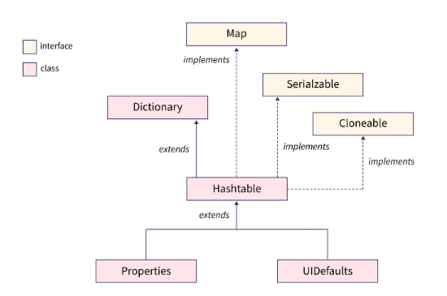

Slide 124
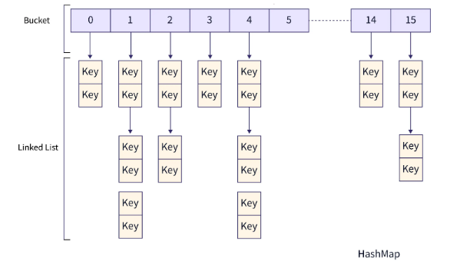

Slide 125
Object put(Object key, Object value) | Maps the specified key to the specified value in this hashtable.
void rehash() | Increases the size of the hash table and rehashes all of its keys.
Object remove(Object key) | Removes the key (and its corresponding value) from this hashtable.
int size() | Returns the number of key-value mappings present in Hashtable.
String toString() | Returns the objects of Hashtable in the form of a set of key-value mappings separated by ", ". The toString() method is used to convert all the elements of Hashtable into String.
Enumeration elements() | Returns an enumeration of the values contained in the hash table.
Object get(Object key) | Returns the value to which the specified key is mapped, or null if the hashtable contains no mapping for the key.
hashcode() | Returns the hash code value for the Map as per the definition in the Map interface.
putAll(Map<? extends K,? extends V> t) | Copies all of the mappings from a given map to the hashtable.
getOrDefault(Object key, V defaultValue) | Returns the value to which the given key is mapped, or defaultValue if the hashtable contains no mapping for the key.
putIfAbsent(K key, V value) | If the specified key is not already mapped with a value, maps it with the given value and returns null, else returns the current mapped value.
keySet() | Returns a view of the keys contained in the hashtable as a set.
entrySet() | Returns a view of the mappings contained in the hashtable as a set.

Slide 126
Methods of Java Hashtable Class
void clear() | Removes all the key-value mappings from a Hashtable and makes it empty.
Object clone() | Creates a shallow copy of the hashtable. All the structure of the hashtable itself is copied, but the keys and values are not cloned. This is a relatively expensive operation.
boolean containsValue(Object value) | Tests if the specified object is a value in the hashtable. Returns true if some value equal to the specified value exists within the hash table. Returns false if the value isn’t found.
boolean containsKey(Object key) | Tests if the specified object is a key in this hashtable.
boolean contains(Object value) | Tests if some key maps into the specified value in this hashtable. This operation is more expensive than the containsKey method. Note that this method is identical in functionality to containsValue, (which is part of the Map interface in the collections framework).
boolean isEmpty() | Tests if the hashtable maps no keys to values.
Enumeration keys() | Returns an enumeration of the keys contained in the hash table.

Slide 127
import java.util.Hashtable;
public class getOrDefaultExample {
public static void main(String[] args)
{
// Declare a new hashtable
Hashtable<Integer, String> hashtable
= new Hashtable<>();
// Adding entries to hashtable
hashtable.put(1, "One");
hashtable.put(2, "Two");
hashtable.put(3, "Three");
hashtable.put(4, "Four");
hashtable.put(5, "Five");
hashtable.put(6, "Six");

Slide 128
// The getOrDefault() method takes if or else statements as arguments.
System.out.println("getOrDefault() prints the value mapped with the key if the key is present!");
System.out.println(hashtable.getOrDefault(2, "Not Found in the Hashtable"));
System.out.println("getOrDefault() prints the default or else statement if the key is not present!");
System.out.println(hashtable.getOrDefault(7, "Not Found in the Hashtable"));
}
}

Slide 129
Properties Class
Properties is a subclass of Hashtable.
It is used to maintain a list of values in which the key is a string and the value is also a string i.e; it can be used to store and retrieve string type data from the properties file.
Properties class can specify other properties list as it’s the default. If a particular key property is not present in the original Properties list, the default properties will be searched.
Properties object does not require external synchronization and Multiple threads can share a single Properties object.
Also, it can be used to retrieve the properties of the system.

Slide 130
Constructors of Properties
1. Properties(): This creates a Properties object that has no default values.
Properties p = new Properties();
2. Properties(Properties propDefault): The second creates an object that uses propDefault for its default value.
Properties p = new Properties(Properties propDefault);
public class Properties extends Hashtable<Object,​Object>

Slide 131
Method | Description
public void load(Reader r) | It loads data from the Reader object.
public void load(InputStream is) | It loads data from the InputStream object
public void loadFromXML(InputStream in) | It is used to load all of the properties represented by the XML document on the specified input stream into this properties table.
public String getProperty(String key) | It returns value based on the key.
public String getProperty(String key, String defaultValue) | It searches for the property with the specified key.
public void setProperty(String key, String value) | It calls the put method of Hashtable.
public void list(PrintStream out) | It is used to print the property list out to the specified output stream.
public void list(PrintWriter out)) | It is used to print the property list out to the specified output stream.
public Enumeration<?> propertyNames()) | It returns an enumeration of all the keys from the property list.
public Set<String> stringPropertyNames() | It returns a set of keys in from property list where the key and its corresponding value are strings.
public void store(Writer w, String comment) | It writes the properties in the writer object.
public void store(OutputStream os, String comment) | It writes the properties in the OutputStream object.
public void storeToXML(OutputStream os, String comment) | It writes the properties in the writer object for generating XML document.
public void storeToXML(Writer w, String comment, String encoding) | It writes the properties in the writer object for generating XML document with the specified encoding.

Slide 132
Example of Properties class to get information from the properties file
import java.util.*;
import java.io.*;
public class Test {
public static void main(String[] args)throws Exception{
FileReader reader=new FileReader("db.properties");
Properties p=new Properties();
p.load(reader);
System.out.println(p.getProperty("user"));
System.out.println(p.getProperty("password"));
}
}

Slide 133
db.properties
user=system
password=oracle
Output:system
oracle

Slide 134
Example of Properties class to get all the system properties
import java.util.*;
import java.io.*;
public class Test {
public static void main(String[] args)throws Exception{
Properties p=System.getProperties();
Set set=p.entrySet();
Iterator itr=set.iterator();
while(itr.hasNext()){
Map.Entry entry=(Map.Entry)itr.next();
System.out.println(entry.getKey()+" = "+entry.getValue());
}
}
}

Slide 135
UNIT-IV
Collections: Overview, Collection Interfaces, Collection Classes, Iterators, List, Set, Maps, Comparator, Arrays, Legacy Classes and Interfaces, StringTokenizer, BitSet, Date, Calendar, Random, Flow, Timer.
https://www.programiz.com/java-programming/vector
https://scanftree.com/java/collection-classes

Slide 136
StringTokenizer
The java.util package has a class called StringTokenizer that is used to tokenize strings.
To put it another way, we can break a sentence up into its words and conduct several operations, such as counting the amount of tokens or splitting a sentence up into tokens.
This StringTokenizer includes constructors and methods that allow us to separate a sentence into tokens. StringTokenizer, tokenize the string on the basis of the delimiters provided to the String tokenizer class object.
Whitespaces, tab, newlines, carriage returns, and form feeds are considered common delimiters.
These delimiters are used by default, however users can define their own delimiters by including them as arguments in the parameter.

Slide 137
Constructors of StringToken
StringTokenizer(String str)
Tokenization of a certain string that is supplied in the parameter is accomplished by this constructor.
All of the standard delimiters specified in the StringTokenizer class description are taken by constructor.
WhiteSpaces, newlines, tabs, carriage returns ("r"), line feeds ("n"), and form feeds ("f") are the delimiters.
2.StringTokenizer(String str, String delimiter) Based on the delimiter the user specifies in the input, this constructor implements string tokenization.
3.StringTokenizer(String str, String delimiter, boolean flag) This constructor has the ability to display the delimiter in addition to doing string tokenization based on the delimiter.

Slide 138
boolean hasMoreTokens() | Return True if more token are available else return False.
String nextToken() | Return next token of StringTokenizer Object
String nextToken(String delim) | Return Next token based on delimeter.
boolean hasMoreElements() | Same as hasMoreTokens()
Object nextElement() | same as nextToken() but its return Object
int countTokens() | count Total number of Token

Slide 139
import java.util.StringTokenizer;
public class classA{
public static void main(String args[]){
StringTokenizer st = new StringTokenizer("String tokenizer is part of java.util");
while (st.hasMoreTokens()) {
System.out.println(st.nextToken());
}
}
}

Slide 140
String
tokenizer
is
part
of
java.util

Slide 141
BitSet Class
The Java BitSet class implements a vector of bits. The BitSet grows automatically as more bits are needed. The BitSet class comes under java.util package.
The BitSet class extends the Object class and provides the implementation of Serializable and Cloneable interfaces.
Each component of bit set contains at least one Boolean value. The contents of one BitSet may be changed by other BitSet using logical AND, logical OR and logical exclusive OR operations. The index of bits of BitSet class is represented by positive integers.
Each element of bits contains either true or false value. Initially, all bits of a set have the false value. A BitSet is not safe for multithreaded use without using external synchronization.

Slide 142
1 | void and(BitSet bitSet) ANDs the contents of the invoking BitSet object with those specified by bitSet. The result is placed into the invoking object.
2 | void andNot(BitSet bitSet) For each 1 bit in bitSet, the corresponding bit in the invoking BitSet is cleared.
3 | int cardinality( ) Returns the number of set bits in the invoking object.
4 | void clear( ) Zeros all bits.
5 | void clear(int index) Zeros the bit specified by index.
6 | void clear(int startIndex, int endIndex) Zeros the bits from startIndex to endIndex.
7 | Object clone( ) Duplicates the invoking BitSet object.
8 | boolean equals(Object bitSet) Returns true if the invoking bit set is equivalent to the one passed in bitSet. Otherwise, the method returns false.
9 | void flip(int index) Reverses the bit specified by the index.

Slide 143
1 | void and(BitSet bitSet) ANDs the contents of the invoking BitSet object with those specified by bitSet. The result is placed into the invoking object.
2 | void andNot(BitSet bitSet) For each 1 bit in bitSet, the corresponding bit in the invoking BitSet is cleared.
3 | int cardinality( ) Returns the number of set bits in the invoking object.
4 | void clear( ) Zeros all bits.
5 | void clear(int index) Zeros the bit specified by index.
6 | void clear(int startIndex, int endIndex) Zeros the bits from startIndex to endIndex.
7 | Object clone( ) Duplicates the invoking BitSet object.
8 | boolean equals(Object bitSet) Returns true if the invoking bit set is equivalent to the one passed in bitSet. Otherwise, the method returns false.
9 | void flip(int index) Reverses the bit specified by the index.
10 | void flip(int startIndex, int endIndex) Reverses the bits from startIndex to endIndex.
11 | boolean get(int index) Returns the current state of the bit at the specified index.
12 | BitSet get(int startIndex, int endIndex) Returns a BitSet that consists of the bits from startIndex to endIndex. The invoking object is not changed.
13 | int hashCode( ) Returns the hash code for the invoking object.
14 | boolean intersects(BitSet bitSet) Returns true if at least one pair of corresponding bits within the invoking object and bitSet are 1.
15 | boolean isEmpty( ) Returns true if all bits in the invoking object are zero.
16 | int length( ) Returns the number of bits required to hold the contents of the invoking BitSet. This value is determined by the location of the last 1 bit.
17 | int nextClearBit(int startIndex) Returns the index of the next cleared bit, (that is, the next zero bit), starting from the index specified by startIndex.
18 | int nextSetBit(int startIndex) Returns the index of the next set bit (that is, the next 1 bit), starting from the index specified by startIndex. If no bit is set, -1 is returned.
19 | void or(BitSet bitSet) ORs the contents of the invoking BitSet object with that specified by bitSet. The result is placed into the invoking object.
20 | void set(int index) Sets the bit specified by index.
21 | void set(int index, boolean v) Sets the bit specified by index to the value passed in v. True sets the bit, false clears the bit.
22 | void set(int startIndex, int endIndex) Sets the bits from startIndex to endIndex.
23 | void set(int startIndex, int endIndex, boolean v) Sets the bits from startIndex to endIndex, to the value passed in v. true sets the bits, false clears the bits.
24 | int size( ) Returns the number of bits in the invoking BitSet object.
25 | String toString( ) Returns the string equivalent of the invoking BitSet object.
26 | void xor(BitSet bitSet) XORs the contents of the invoking BitSet object with that specified by bitSet. The result is placed into the invoking object.

Slide 144
import java.util.BitSet;
public class BitSetAndExample2 {
public static void main(String[] args) {
// create 2 bitsets
BitSet bitset1 = new BitSet();
BitSet bitset2 = new BitSet();
// assign values to bitset1
bitset1.set('a');
bitset1.set('b');
bitset1.set('c');
bitset1.set(4);
bitset1.set(5);

Slide 145
// assign values to bitset2
bitset2.set(97);
bitset2.set(98);
bitset2.set(3);
bitset2.set(4);
bitset2.set(6);
// print the sets
System.out.println("bitset1: " + bitset1);
System.out.println("bitset2: " + bitset2);
// perform and operation between two bitsets
bitset1.and(bitset2);
// print the new bitset1
System.out.println("result bitset: " + bitset1);
}
}

Slide 146
Calendar Class
Java Calendar class is an abstract class that provides methods for converting date between a specific instant in time and a set of calendar fields such as MONTH, YEAR, HOUR, etc.
It inherits Object class and implements the Comparable interface
public abstract class Calendar extends Object
implements Serializable, Cloneable, Comparable<Calendar>

Slide 147
import java.util.Calendar;
public class CalendarExample1 {
public static void main(String[] args) {
Calendar calendar = Calendar.getInstance();
System.out.println("The current date is : " + calendar.getTime());
calendar.add(Calendar.DATE, -15);
System.out.println("15 days ago: " + calendar.getTime());
calendar.add(Calendar.MONTH, 4);
System.out.println("4 months later: " + calendar.getTime());
calendar.add(Calendar.YEAR, 2);
System.out.println("2 years later: " + calendar.getTime());
}
}

Slide 148
Output:
The current date is : Thu Jan 19 18:47:02 IST
2017 15 days ago: Wed Jan 04 18:47:02 IST
2017 4 months later: Thu May 04 18:47:02 IST
2017 2 years later: Sat May 04 18:47:02 IST 2019

Slide 149
Date
The java.util.Date class represents date and time in java. It provides constructors and methods to deal with date and time in java.
The java.util.Date class implements Serializable, Cloneable and Comparable<Date> interface. It is inherited by java.sql.Date, java.sql.Time and java.sql.Timestamp interfaces.
After Calendar class, most of the constructors and methods of java.util.Date class has been deprecated.

Slide 150
Date Constructors
Date()Creates a date object representing current date and time.
Date(long milliseconds)Creates a date object for the given milliseconds since January 1, 1970, 00:00:00 GMT.

Slide 151
import java. util.Date;
public class Main
{
public static void main(String[] args)
{
Date date1 = new Date(2017, 12, 18);
Date date2 = new Date(2017, 8, 27);
int comparison1 = date1.compareTo(date2); // d1 > d2
int comparison2 = date2.compareTo(date1); // d2 > d1
int comparison3 = date1.compareTo(date1); // d1 = d1
System.out.println("Output of comparison1 is "+ comparison1);// 1
System.out.println("Output of comparison2 is "+ comparison2);//-1
System.out.println("Output of comparison3 is "+ comparison3);//0
boolean res=date1.equals(date1);
System.out.println(res);
long time1=date1.getTime();
System.out.println(time1);
}
}

Slide 152
Random Class
Random class in Java which is present in the util package helps in generating random values of different data types like integer, float, double, long, boolean, etc.
We can even mention the range in which we want the random number to be generated. Instances of java. util.Random is thread-safe.

Slide 153
import java.util.Random;
public class JavaRandomExample1 {
public static void main(String[] args) {
//create random object
Random random= new Random();
//returns unlimited stream of pseudorandom long values
System.out.println("Longs value : "+random.longs());
// Returns the next pseudorandom boolean value
boolean val = random.nextBoolean();
System.out.println("Random boolean value : "+val);
byte[] bytes = new byte[10];
//generates random bytes and put them in an array
random.nextBytes(bytes);
System.out.print("Random bytes = ( ");
for(int i = 0; i< bytes.length; i++)
{
System.out.printf("%d ", bytes[i]);
}
System.out.print(")");
}
}

Slide 154
Timer class
The Java Timer class provides a facility for the thread to schedule tasks for future execution in a background thread.
This class is thread-safe that means multiple class can share a single Timer object without using the external synchronization.

Slide 155
1 | cancel() | It is used to stop the timer and remove the currently scheduled task.
2 | Purge() | It is used to cancel the tasks present in TimerTask Chain.
3 | scheduleAtFixedRate(TimerTask task, Date firstTime, long period) | It is used to schedules the specified task for repeated fixed-rate execution, beginning at the specified time.
4 | scheduleAtFixedRate(TimerTask task, long delay, long period) | It is used to schedules the specified task for repeated fixed-rate execution, beginning after the specified delay.
5 | schedule(TimerTask task, Date firstTime, long period) | It is used to schedules the specified task for repeated fixed-delay execution, beginning at the specified time.
6 | schedule(TimerTask task, Date time) | It is used to schedules the specified task for execution at the specified time.

Slide 156
import java.util.*;
public class JavaTimerCancleExample2{
public static void main(String[] args) {
Timer t = new Timer();
TimerTask tt = new TimerTask() {
@Override
public void run() {
for(int i=1; i<=10;i++)
{
System.out.println("working on");
if(i>=5)
{
System.out.println("Task is stop");
t.cancel();
}
}
};
};
t.schedule(tt,1000,1000);
}
}

Slide 157
Flow API
Flow API is official support for reactive streams specification since Java 9. It is a combination of both Iterator and Observer patterns. The Flow API is an interoperation specification and not an end-user API like RxJava.
Flow API consists of four basic interfaces:
Subscriber: The Subscriber subscribes to Publisher for callbacks.
Publisher: The Publisher publishes the stream of data items to the registered subscribers.
Subscription: The link between publisher and subscriber.
Processor: The processor sits between Publisher and Subscriber, and transforms one stream to another.

Slide 158
How to use Collections
A Collection in Java refers to a single unit that contains a group of objects.
A separate Collection Framework was needed to have a standard implementation for objects.
The List interface is implemented by LinkedList, ArrayList, Vectors, and Stack classes.
The Queue interface is implemented by PriorityQueue.
The Set Interface is implemented by HashedSet, LinkedHashSet, and TreeSet.

Slide 159
The Map interface is implemented by HashMap.
ArrayList is good for searching a particular element using array index. ArrayLists are dynamic which is advantageous over arrays.
Linked list is good for insertion and deletion operations.
Set is used to store unique elements.
Map is used when to store key-value pairs, Hash map is used in Java to build caching mechanism.

